Slide 1
Multi-Observer Verification
Shaokai Lin
Last Updated: 06/08/2021
Notes:
Hello everyone, my presentation today is on ...
Alright. let’s get started.

Slide 2
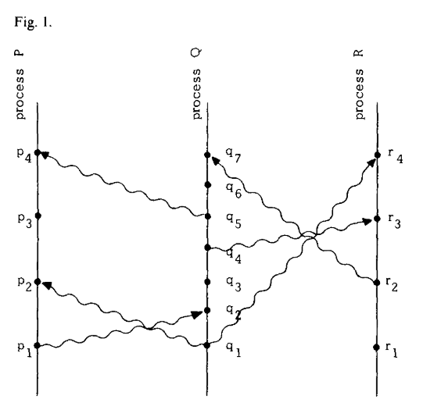
Roadmap
The partial ordering of events & Lamport’s logical clock
Reactors as observers
Encoding observers operationally and axiomatically
Current experiments
A Simple Distributed System
[Lamport, 1978]
Notes:
My presentation will contain four parts:
1.
2.
3.
4.

Slide 3
The partial ordering of events & Lamport’s logical clock
A Simple Distributed System
[Lamport, 1978]
Notes:
So let’s get started with Lamport’s Logical Clocks.

Slide 4
The Ordering of Events in Everyday Life
t
A
B
“Event A happened before event B.”
Notes:
It is quite natural for us humans to assign temporal relations to two events:
“Event a happens before event b.”
E.g. I can make a statement like ”I opened my computer before joining this zoom meeting.”
And e.g. “I submitted my paper 1 minute before the AOE deadline.” etc.
It is also could be intuitive to treat the temporal ordering of events as a total order and to think that there is a global notion of time.
However, the question becomes much more subtle when we dive into this problem.

Slide 5
Distributed Systems
A Computer Network
A Computer
Notes:
Lamport defines a distributed system as “a system that consists of a collection of distinct processes which are spatially separated,
And which communicate with one another by exchanging messages.”
This is, in fact, a very broad definition. We can say that a computer network is a distributed system.
However, under this definition, I can also say that a single computer can also be viewed as a distributed system,
In which the CPU, the memory units, and IO channels are all separate processes.
So distributed systems are everywhere and, as Lamport says, a system is distribued if the message transmission delay is not negligible
Compared to the time between events in a single process.

Slide 6
The Partial Ordering
Statement: Event A happened before event B.
How should we define “happened before”?
Should we use real clocks?
Lamport: “We should not define ”happened before” using real clocks because they are not perfectly accurate and are not synchronized.”
[Lamport, 1978]
Notes:
Most people say “event a happens before event b” when the time event a happened is earlier than the time event b happened.
But to check whether this statement is correct, we need to first define what events are observable in the system and second, what is an event.
In the case above, most people defined the “happened before” relation using physical time, which involves real clocks.
However, defining “happened before”
using real clocks can be problematic, as clocks are not perfectly accurate and not perfectly synchronized with each other.
[As a fun fact, the fact that we cannot perfectly synchronize two real clocks is the reason why we cannot measure the one-way speed of light.]
So Lamport defines ”happened before” without using physical clocks.
The definition of events is also application-dependent: it can be the execution of a subprogram on a computer or the execution of a single instruction.
Nevertheless, we can assume that the events of a process form a sequence, where a occurs before b. A single process is defined to be a set of events
With an a priori total ordering.

Slide 7
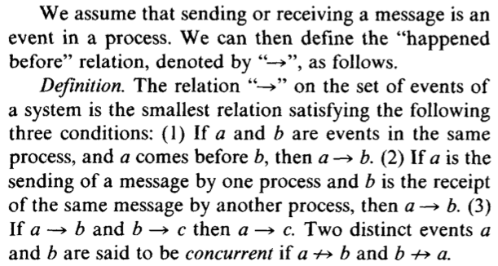
The Partial Ordering
Lamport: ﻿”In a distributed system, it is sometimes impossible to say that one of two events occurred first. The relation "happened before" is therefore only a partial ordering of the events in the system.“
[Lamport, 1978]
Notes:
Let’s take a closer look at the definition.
[Give examples and draw on screen.]
Also under this definition, if we can trace a path between two events, a and b, then we can say that a happened before b.
Fig.1 is also known as a space-time diagram. The horizontal direction represents space and the vertical direction represents time. This type of diagram is also used by physicists in formulating special relativity,
which states that the spacetime is relativistic. Events are measured w.r.t. an observer, which defines a frame of reference. We will come back to this point later.
Lamport says we can also interpret the “happened before” relation in the context of influence. If event a happens before event b, then a can causally affect b, in other words, a can influence b.
Under this definition of “happened before”, Lamport says: In a distributed system, it is sometimes impossible to say that one of two events occurred first.
The relation "happened before" is therefore only a partial ordering of the events in the system.
In other words, we cannot have a notion of a global state without specifying who the observer is and what events are observable.
After we define the observers, the events, and the happened before relation, we can make statements that hold w.r.t. all observers in the system.
This is rooted in special relativity. While all observers might disagree about the time and the space where certain events happen. They agree with the causality of events.
More specifically, the spacetime interval is preserved.

Slide 8
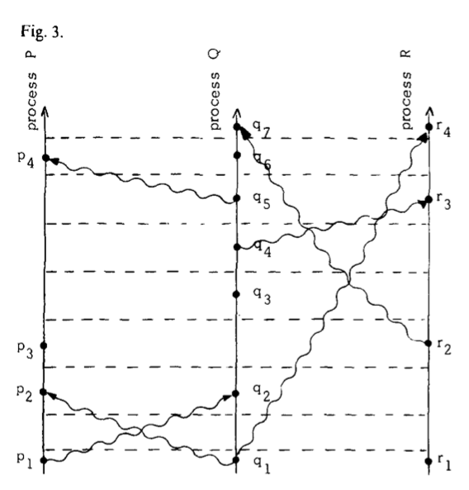
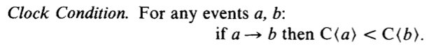
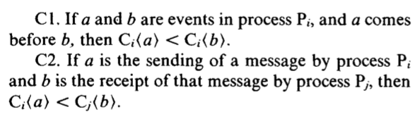
Logical Clocks to the Rescue
Clock Condition is satisfied if the following conditions hold:
[Lamport, 1978]
Notes:
So given that the events in the system are partially ordered under the definition of “happened before”,
How do we totally order events in the system? Intuitively, how do we define a common notion of “time” between the processes?
Determining a total order in a distributed system is very useful.
Things like distributed database relies on a mechanism to determine the order of queries.
To achieve this goal, Lamport introduces logical clocks.
A valid logical clocks satisfies the clock condition, which says if event a happens before event b, then the logical time when a happened is less than the logical time when b happened.
The clock condition is satisfied when the following conditions hold.
We can see that we can use logical clocks to define a total order of events. If C(a) < C(b), then a -> b. If C(a) = C(b), we can use an arbitrary order to break the ties. For example, we can define
Process P to precede Q and Q precede R when the logical time values are equal.

Slide 9
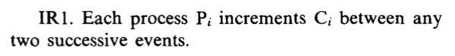
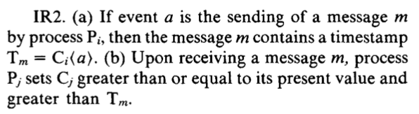
Implementing Logical Clocks
[Lamport, 1978]

Slide 10


Reactors
C
Reactors as observers
Instr.
Gates
Transistors
Electrons
Physical

Slide 11
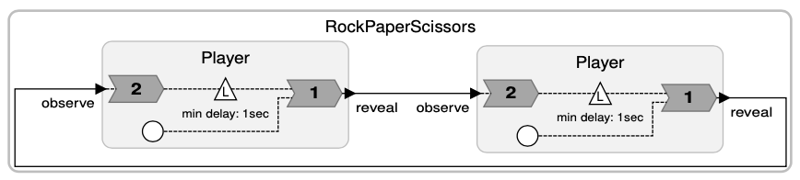
Reaction Graph and Reaction Precedence
To define the causal relations at a particular logical instant, we can define the “reaction precedence” relation using a reaction graph.
In a reaction graph:
Reactions are nodes.
Edges indicate dependencies between reactions due to connections and reaction priority.
Acyclic (no causality loops)
We can use the reaction graph to define a transitive relation, “reaction precedence.”
If there exists a path from node A to node B, then A precedes B in the reaction graph.
L2
L1
R2
R1
[Lohstroh, 2020]
Notes:
currently we conservatively reject federate-level feedback loops

Slide 12
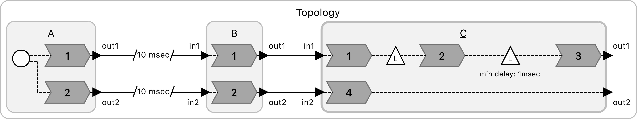
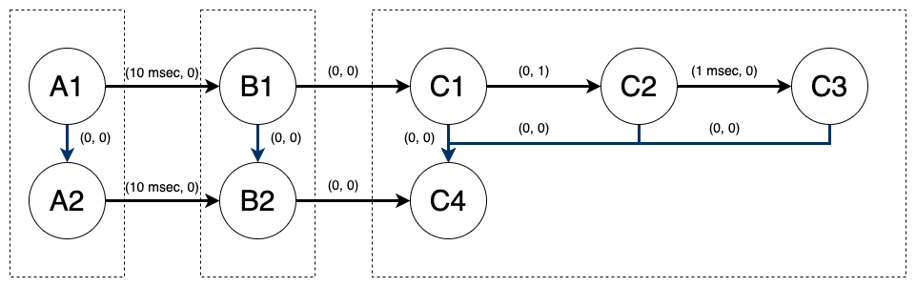
Connectivity Graph
Connectivity of the system can be modeled as a directed weighted graph. Reactions are vertices. Logical actions and connections are edges, with logical delays being weights.
A superset of the precedence graph
Can be cyclic.
Traversing the connectivity graph generates a set of events that can possibly happen during an execution. (Note: In UCLID5, this is done symbolically.)

Slide 13
(TODO) What are Observers here?
Observer is best understood as a “frame of reference.”
It represents a valid interpretation of the order of distributed events.
An observer defines a total-order trace, which is a possible linearization of the partial order trace.

Slide 14
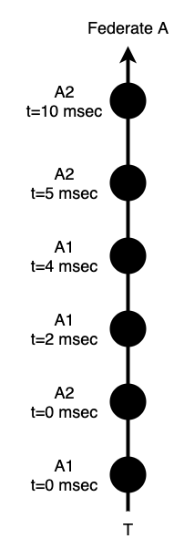
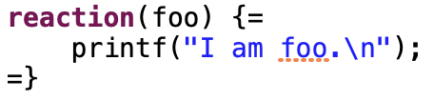
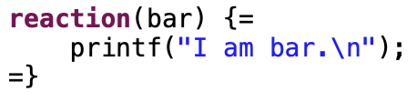
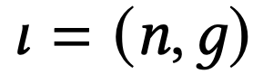
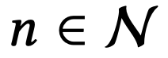
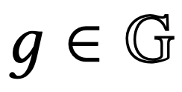
Reaction Invocation
A1:
Going back to the question:
what are the events here?
For Reactors, a suitable candidate is reaction invocation.
Reaction invocation is defined as a tuple where is a reaction and is the logical time tag at the instant of the invocation.
A2:
Notes:
So going back to Lamport’s question: what are the observable events?

Slide 15
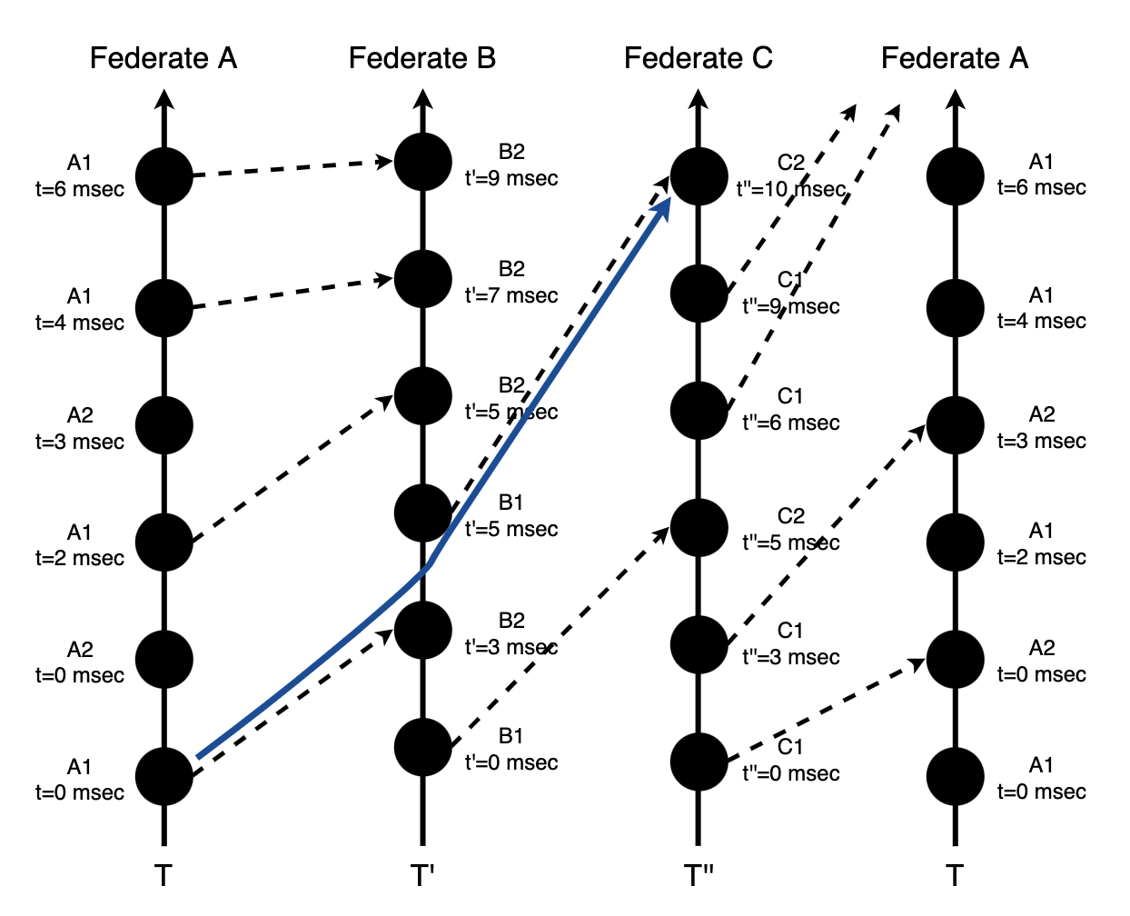
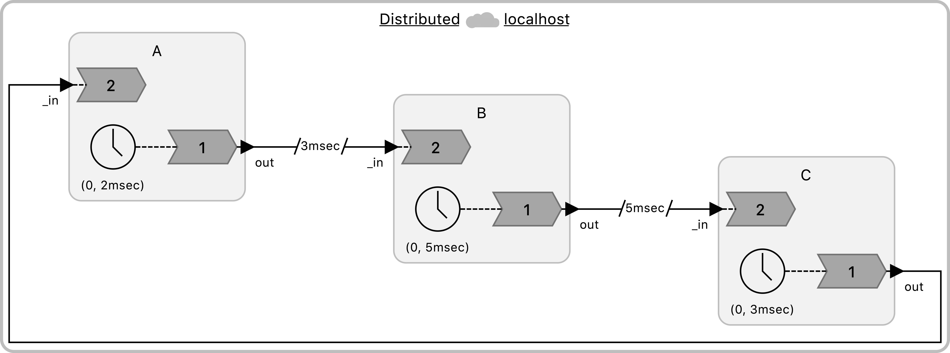
Mapping Events onto Partial-Order Trace

Slide 16
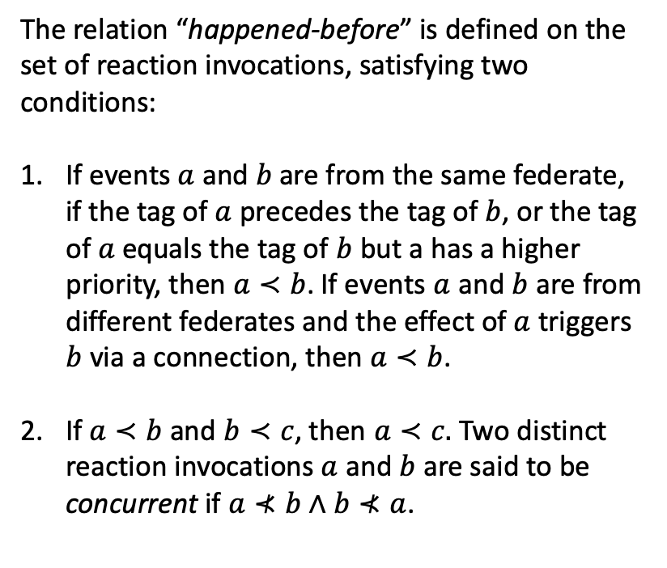
Defining “Happened-Before” in Reactors
The relation “happened-before” is defined on the set of reaction invocations, satisfying two conditions:
If events $a$ and $b$ are from the same federate, if the tag of $a$ precedes the tag of $b$, or the tag of $a$ equals the tag of $b$ but a has a higher priority, then $a≺b$. If events $a$ and $b$ are from different federates and the effect of $a$ triggers $b$ via a connection, then $a≺b$.
If $a≺b$ and $b≺c$, then $a≺c.$ Two distinct reaction invocations $a$ and $b$ are said to be concurrent if $a⊀b∧b⊀a$.

Slide 17
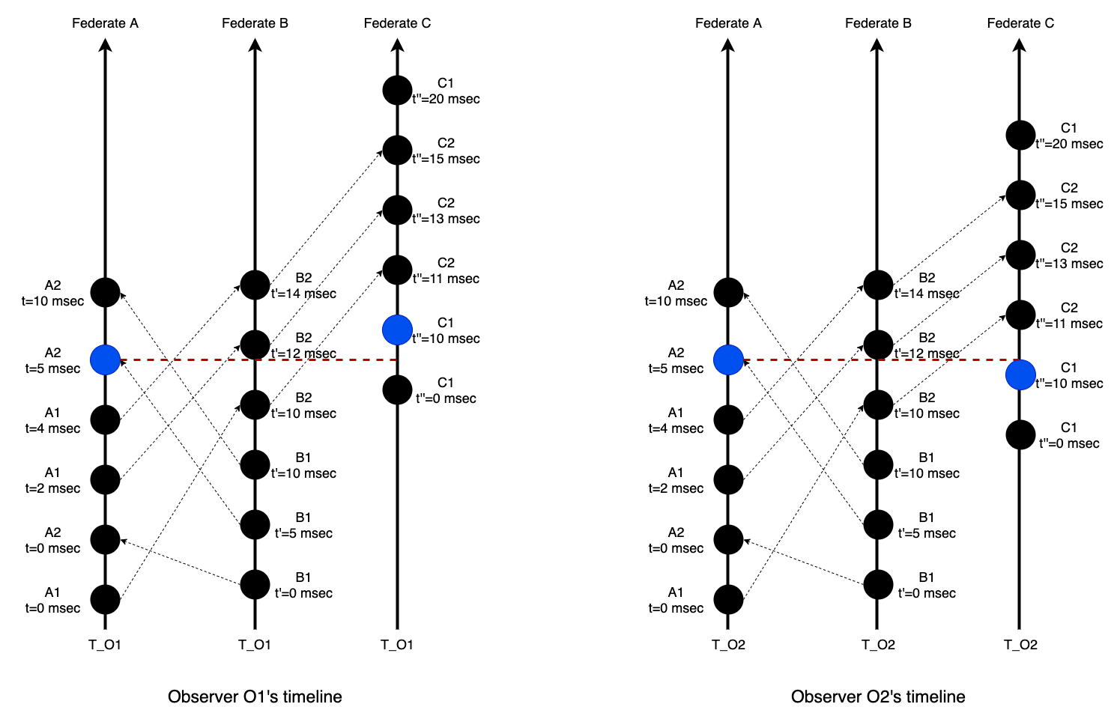
Two Equally Valid Frames of Reference

Slide 18
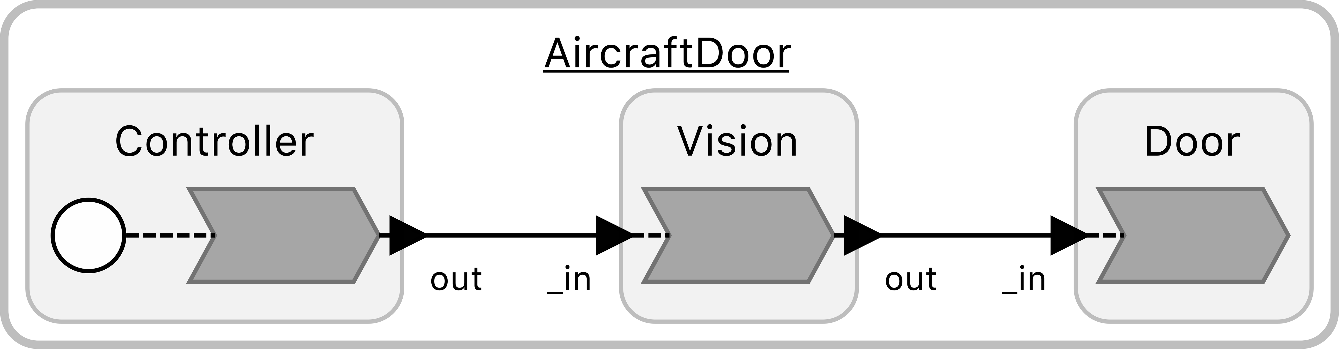
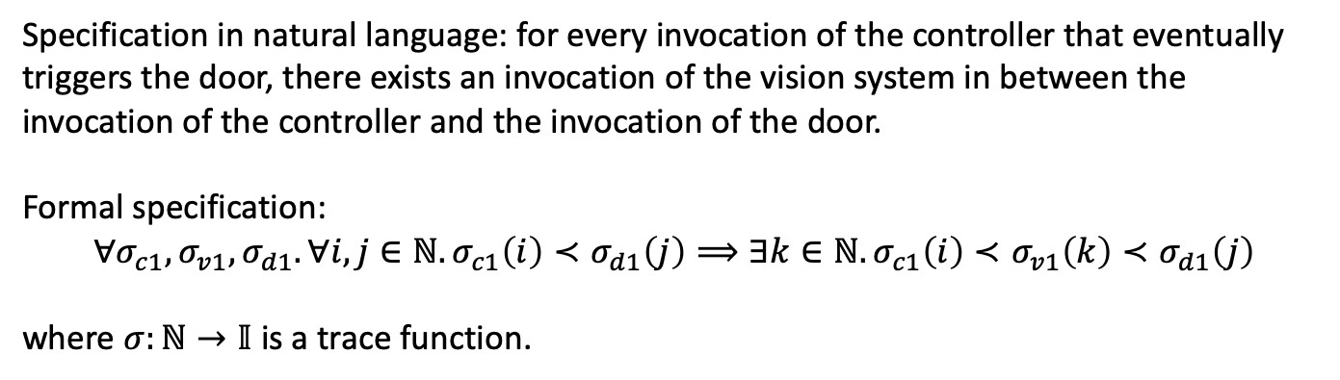
Using “Happened-Before” in Specifications
C1
V1
D1
Specification in natural language: for every invocation of the controller that eventually triggers the door, there exists an invocation of the vision system in between the invocation of the controller and the invocation of the door.
Formal specification:
$$∀σ_{c1}, σ_{v1},σ_{d1}. ∀i,j∈ℕ. σ_{c1}\left(i\right)≺σ_{d1}\left(j\right)⟹∃k∈ℕ. σ_{c1}\left(i\right)≺σ_{v1}\left(k\right)≺σ_{d1}\left(j\right)$$
where $σ:ℕ→𝕀$ is a trace function.
Notes:
FIXME: natural language specification is not equivalent to the formal specification.

Slide 19
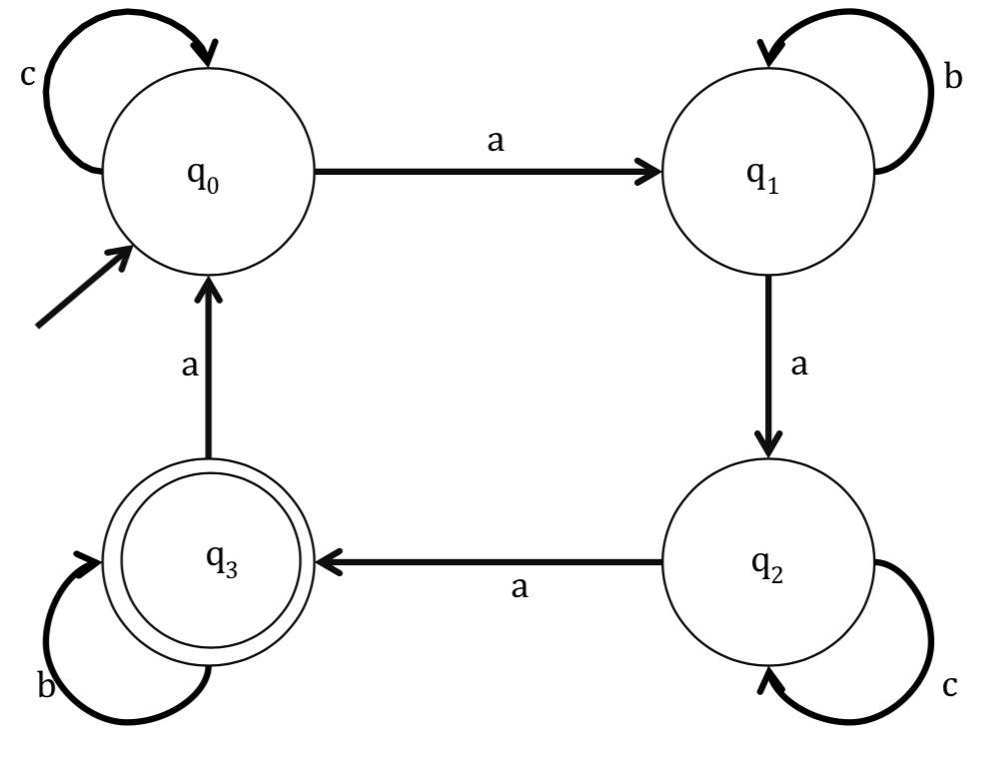
Model Checking w.r.t. Observers
A transition system
Has a global state
Properties are checked w.r.t. state variables at a particular step in the transition.
A system of observers
Observers have individual traces and events are partially ordered.
Properties are checked w.r.t. traces and a set of predefined rules to determine the order of events agreed by all observers.
Notes:
So how have things changed?
Before: a global transition system in which events are totally ordered.
Properties are checked wrt a particular

Slide 20
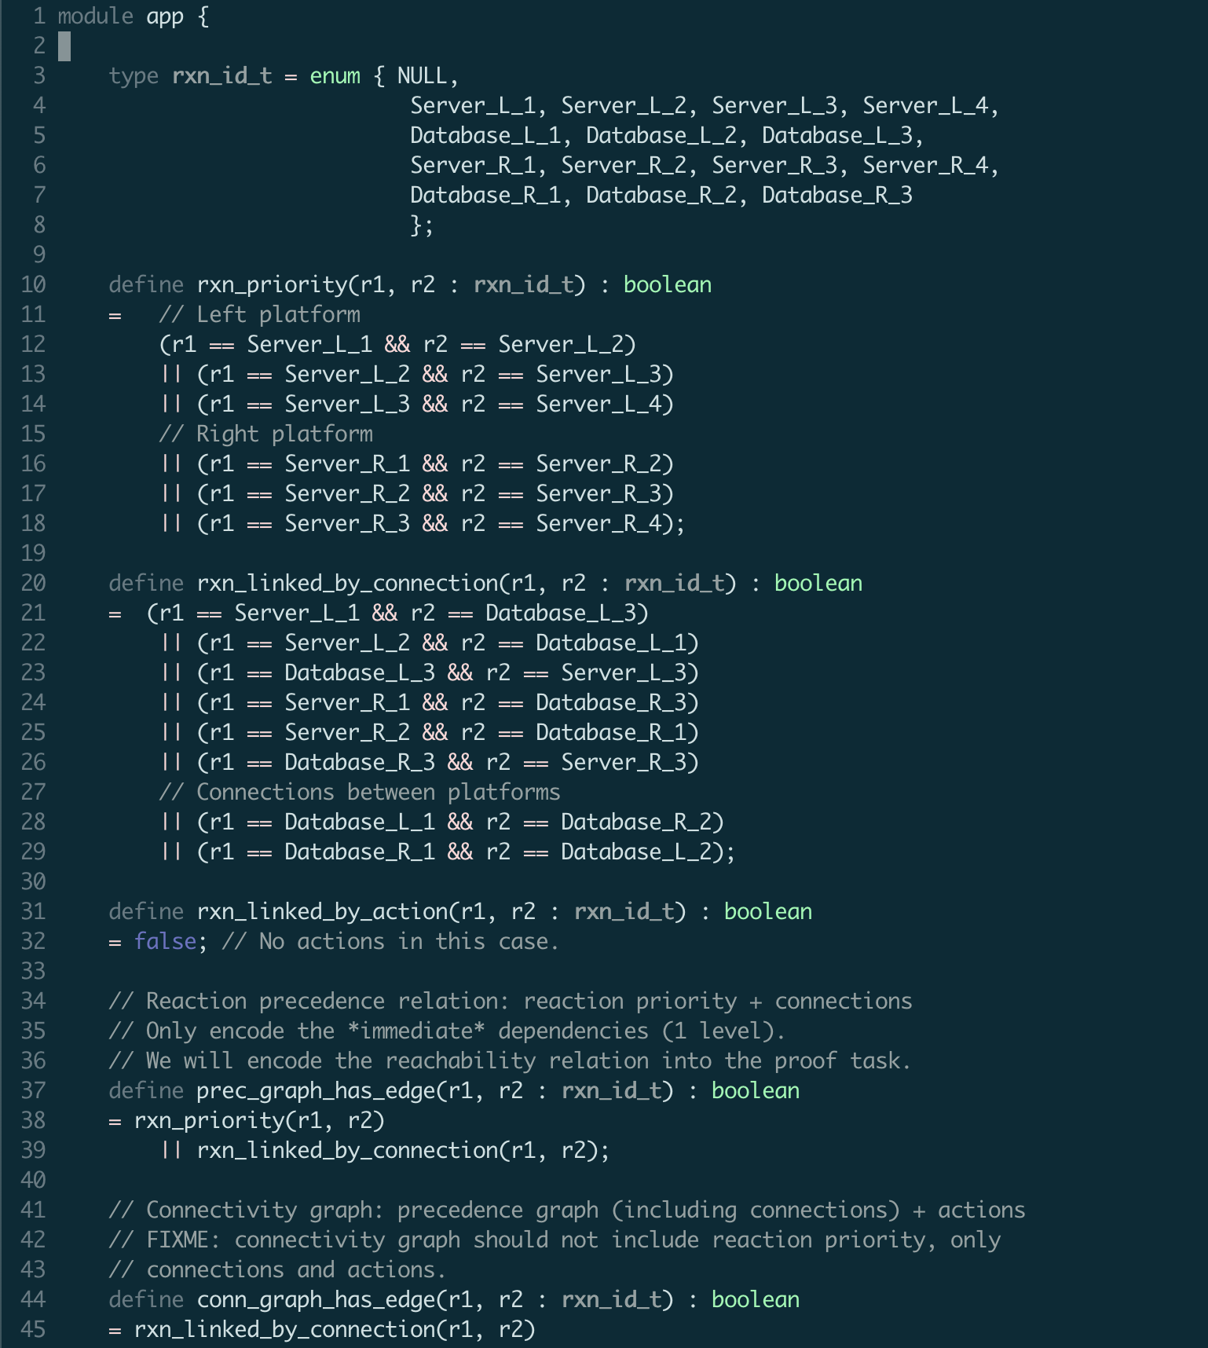
The Axiomatic Encoding

Slide 21
In Progress
Dynamic information
Specification language
Code generation

Slide 22
Blank

